Slide 1
PACE sewage rapid response
Graham Trolley
Antonios river flow rate estimate: https://www.facebook.com/groups/CBVA.CommunityNews/posts/1827608051238214/

Slide 2
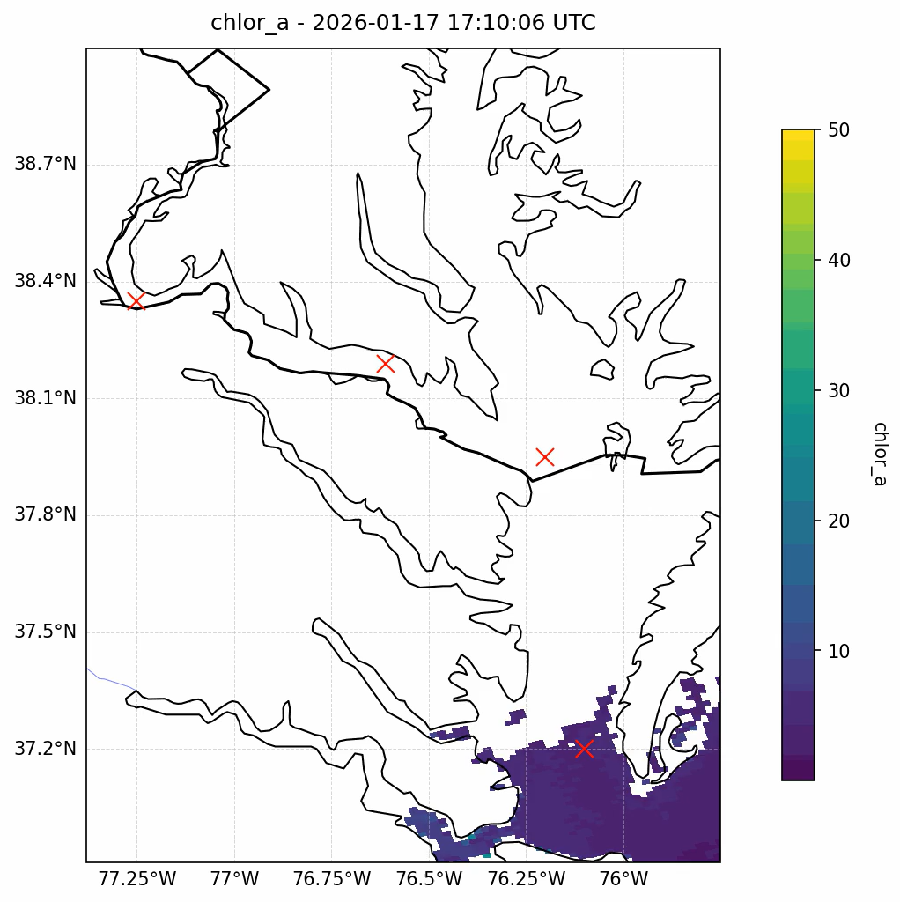
Data points
A: -76.1, 37.2
B: -76.2, 37.95
C: -76.61, 38.19
D: -77.25, 38.35
Sewage spill occurred on jan 19 - grey line In plots
https://www.dcwater.com/about-dc-water/media/potomac-interceptor-collapse
A
B
C
D

Slide 3
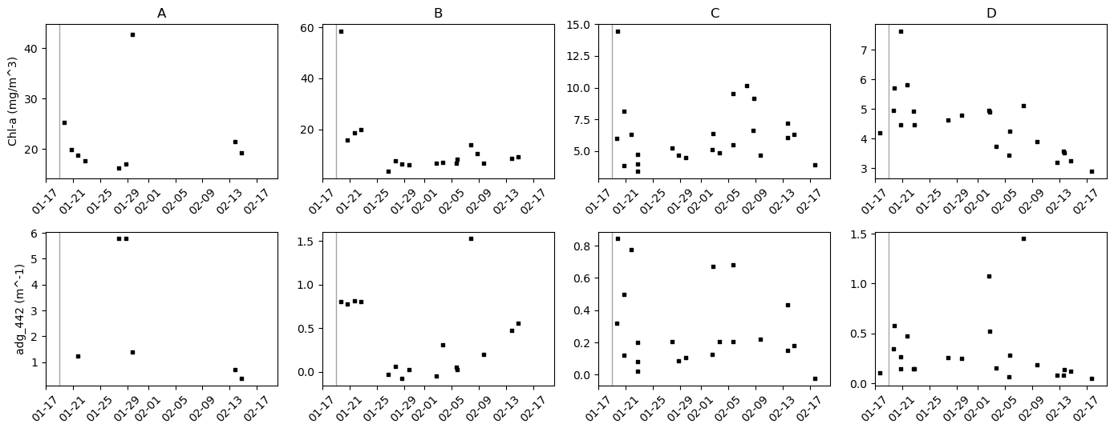
Chl-a, adg_442 time series

Slide 4
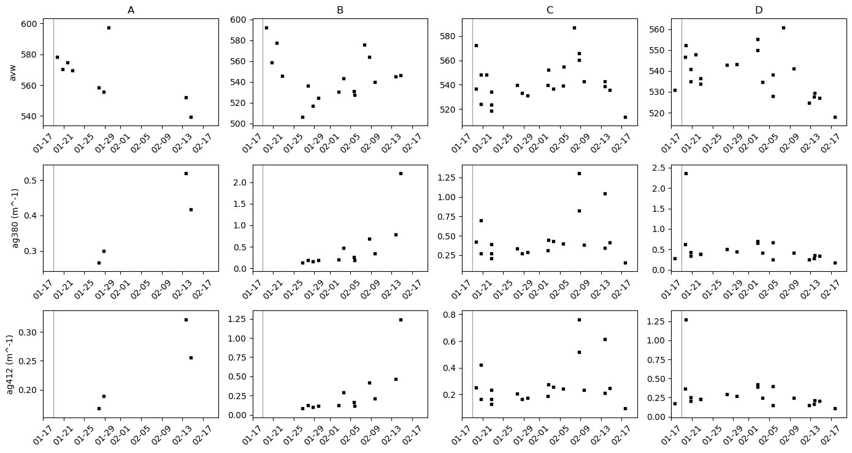
Next up - AVW, a412, slope, DOC2 (from aop granule)
AVW, ag380, ag412

Slide 5
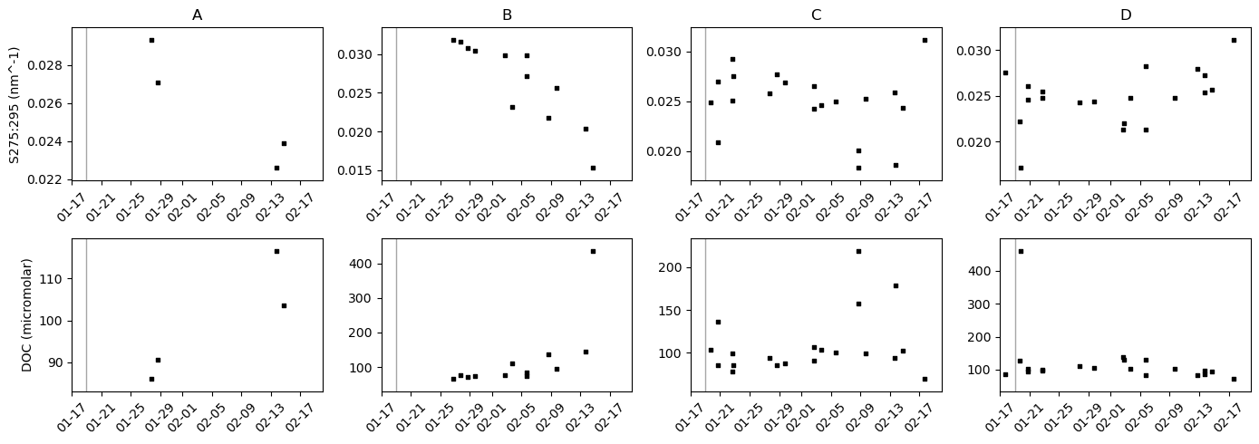
Sg275:295, DOC

Slide 6
Flow rate math?
Difficulty finding sources

